Slide 1

521146S - Research Methods in Computer Science 3. Statistics II
Prof. Vassilis Kostakos

Slide 2
Schedule
Week |  | Session 1 - Theory | Session 2 – Practice | TA
1 | Oct 6 | Introduction & Research planning | Lab session: develop a research plan | Jorge & Denzil
2 | Oct 13 | Statistics 1 | Lab session on SPSS | Jorge & Denzil
3 | Oct 20 | Statistics 2 | Presentation of Exercise 1 | All
4 | Oct 27 | Research methods | Presentation of Exercise 2 | All
5 | Nov 3 | Humans | Lab session on human research | Jorge & Denzil
6 | Nov 10 | Research tools | Presentation of Exercise 3 | All
7 | Nov 17 | Academic writing | Academic writing workshop | Jorge & Denzil
8 | Nov 24 | Exercise 4 one-on-one feedback |  | Vassilis
9 | Dec 1 | Presentation skills | Improv class | All
10 | Dec 8 | Presentation of exercise 4 |  | All

Slide 3
“Doing research”
Week 1
Planning
Week 4
Methods
Week 5
Tools
Week 2&3
Stats

Slide 4
Outline
Exploring data
Correlation
Regression
Comparing means
Non-parametric tests
Categorical data

Slide 5
When do you compare means?
When the data naturally splits in 2 or more groups
And we are interested in comparing the groups
Examples
The performance of system X was tested across 3 operating systems 20 times. (3 groups, 20 data points per group)
The loading time of the web page was measured 5 times using 8 different web browsers (8 groups, 5 data points per group).
10 users performed the hand gesture with their left hand, and 10 users with their right hand, each 50 times (2 groups, 10x50 data points)

Slide 6
Comparing two means
Useful when we only have two sets, nothing else.
Two sample t-test for independent samples
Compare two sample means
Samples are independent of each other
Two sample t-test for dependent samples
Compare two sample means
Samples are paired / dependent

Slide 7
Independent vs. Dependent
The data in each of the two sets is collected from separate entities.
One group of patients received Drug A, the other Drug B
The software was used by a group of men and a group of women.
The data in each of the two sets is collected from the same entities
The group of patients tried Drug A for a week, and then Drug B for a week.
The users tried Microsoft windows and the Apple OS X.
NB: The samples are “paired”.

Slide 8
What does the test tell me?
The t-test will give you:
The probability that the difference in the means that is observed is “due to chance”.
This is called the “p” value, and as a convention we have agreed that
a p value more than 0.05 (i.e. 5%) is “due to chance”
a p value less than 0.05 (i.e. 5%) is not “due to chance”

Slide 9
Comparing more than 2 means
This is typically the most useful type of test.
“We observed that the website loading time was significantly faster on Chrome other browsers”.
Did you account for operating system?
Did you account for RAM?
The way to account for multiple variables is to design an experiment where more than 2 means will be compared.

Slide 10
Accounting for variables (1-way ANOVA)
Browser | Loading time
Chrome | Run 10 trials and average the results
Firefox | Run 10 trials and average the results
Opera | Run 10 trials and average the results
Safari | Run 10 trials and average the results

Slide 11
1-way ANOVA
Accounts for more than 2 sets.
Tells us if the difference in means across the sets is significant.
Produces a p-value, which we interpret as before.

Slide 12
Can’t I just run many t-tests?
Browser | Loading time
Chrome | Run 10 trials and average the results
Firefox | Run 10 trials and average the results
Opera | Run 10 trials and average the results
Safari | Run 10 trials and average the results
Too many errors
are introduced

Slide 13
Controlling for more variables
“Browser” vs. “OS”
“Browser has 4 levels
“OS” has 3 levels
4x3 design
Two-way ANOVA
(Loading time) | Windows | Linux | Mac OS
Chrome | Run 10 trials and average the results | Run 10 trials and average the results | Run 10 trials and average the results
Firefox | Run 10 trials and average the results | Run 10 trials and average the results | Run 10 trials and average the results
Opera | Run 10 trials and average the results | Run 10 trials and average the results | Run 10 trials and average the results
Safari | Run 10 trials and average the results | Run 10 trials and average the results | Run 10 trials and average the results

Slide 14
Other ways to control a variable
Adding one more variable to the experimental design is not the only way to control for it.
For example, in this case study we can keep RAM constant at 4GB.
We can also add one more variable, “RAM”, with levels 1GB, 2GB, 4GB
then we will have a 4x3x3 design
TIP: Control the things you do not care about by keeping them constant, only manipulate what you are interested in.

Slide 15
What does the ANOVA tell me?
The probability (p-value) that the effect of a particular variable (Browser or OS) on loading times is due to chance.
In this case, you will get one p-value for BROWSER, and another p-value for OS.
Interpret the p-values as before.

Slide 16
Post-hoc tests
The test is telling me that OS has a significant effect on loading times (e.g. p = 0.02).
But which OS is the fastest?
Post-hoc tests can tell you this
A post hoc test will do an exhaustive pair-wise comparison of all levels of a variable
Linux vs. Windows, Linux vs. Mac, Windows vs. Mac
It will tell you (again, using p-values) which level is significantly higher than which other level.

Slide 17
Effect significance vs. effect size
Do not confuse the significance of an effect “p-value” with the magnitude of an effect.
the means of two groups may be different by 5 seconds, but this may not be significant (i.e. p>0.05)
the means of two other groups may be different by 0.1 second, and this may be significant (i.e. p<0.05).
Why should I care if a “small” effect is actually significant?
are 60 nanoseconds (0.0000006 seconds) “small”?

Slide 18
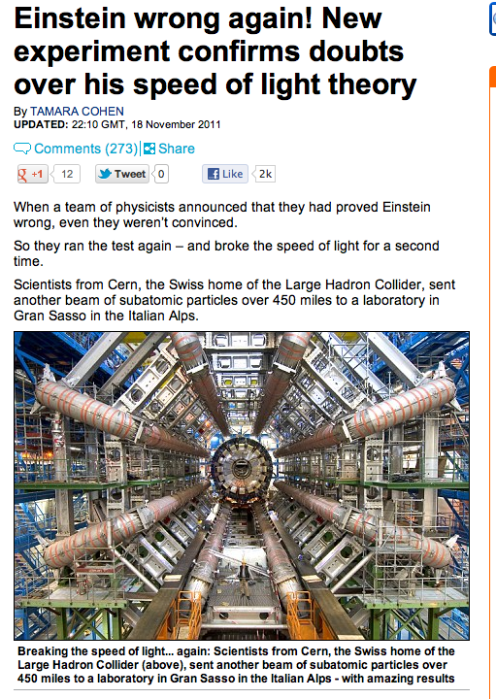

Slide 19
Outline
Exploring data
Correlation
Regression
Comparing means
Non-parametric tests
Categorical data

Slide 20
Non-parametric tests
Useful when your data is not normally distributed
and the data cannot be corrected via transformations
They make very few assumptions about the data
They rely on the principle of ranking
The lowest score gets value 1, the second-lowest gets value 2, etc.
The analysis is then done on the ranks
Downside: the tests have less “power”
More likely to suggest a significant finding

Slide 21
Tests
Compare two independent conditions
Wilcoxon Rank-Sum Test
(like the T-test for independent samples)
Compare two related conditions:
Wilcoxon signed-rank test
(like the T-test for dependent samples)
Differences between several independent groups
Kruskal-Wallis Test
One-way ANOVA
Differences between several related groups
Friedman’s ANOVA
Multi-way ANOVA

Slide 22
Outline
Exploring data
Correlation
Regression
Comparing means
Non-parametric tests
Categorical data

Slide 23
What is categorical data?
Gender (male/female)
Pregnancy (yes/no)
Voting (Obama / Bush)
Likert scales
It does not make sense to put these things on a scale
They are categories
Sometimes we want to look for the relationship between such variables.

Slide 24
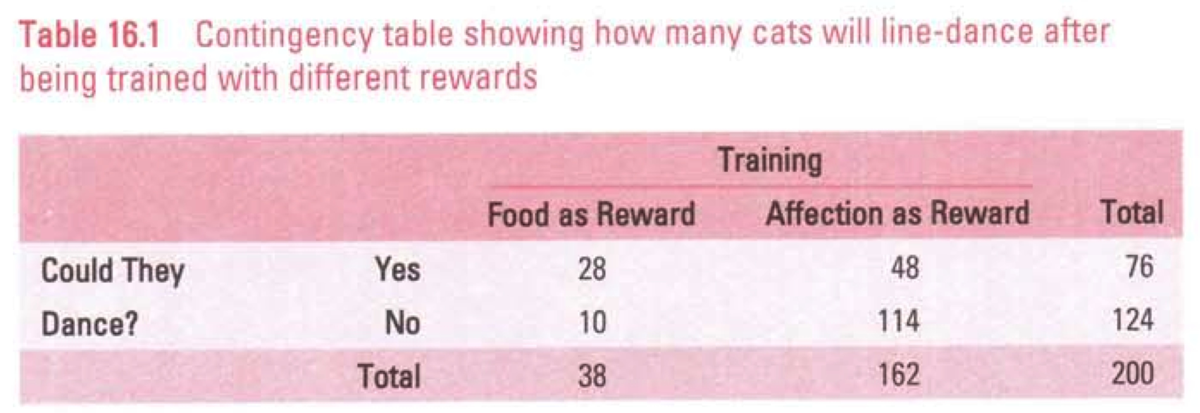
The chi-square test is your friend
Works on “contingency tables”
Tells you whether two variables are “related”
Cannot do a correlation!

Slide 25
Details
Each entity/person/cat must be counted only once in the contingency table
Values must not be too low
The chi-square test give a p-value (same as before), which tell us whether:
The distribution of frequencies in the contingency table is similar to the frequencies you would expect in a random allocation
If there is “skewing” or higher frequency than randomly expected, this test will tell you so

Slide 26
Experimental design – “design the squares”

Slide 27
Controlling your experiment
Your uttermost objective is to conduct a fair and unbiased test
Describe it in enough detail so that it can be reproduced
Keep things constant
Alternate things
Randomize things

Slide 28
What to keep constant
Variables or settings that can influence your results, but are not of interest to you.
For benchmarking, we usually keep the hardware the same.
When dealing with humans, we keep the instructions the same.
For performance tests, we keep the task/activity the same.

Slide 29
What to alternate
You need to alternate anything that may be affected by the order in which it is used.
For example, having meat then dessert is not the same as having dessert then meat.
Trying system A and then system B is not the same as trying system B and then system A
Or is it?
That is why we alternate, or “counter-balance”.

Slide 30
What to randomize
Usually, we want to randomize our samples
How we recruit people should be random
Not your “mates”
They are not representative of the population!
We randomize who goes in which group
Allocate people to conditions randomly
Or pseudo-randomly to ensure balanced groups

Slide 31
